Slide 1


Team
Bank of America
Leveraging Bank’s Data to Predict US Retail Sales
Members
Teddy, Andrew, Vasavi and Om
Mentor Yan Peng

Slide 2
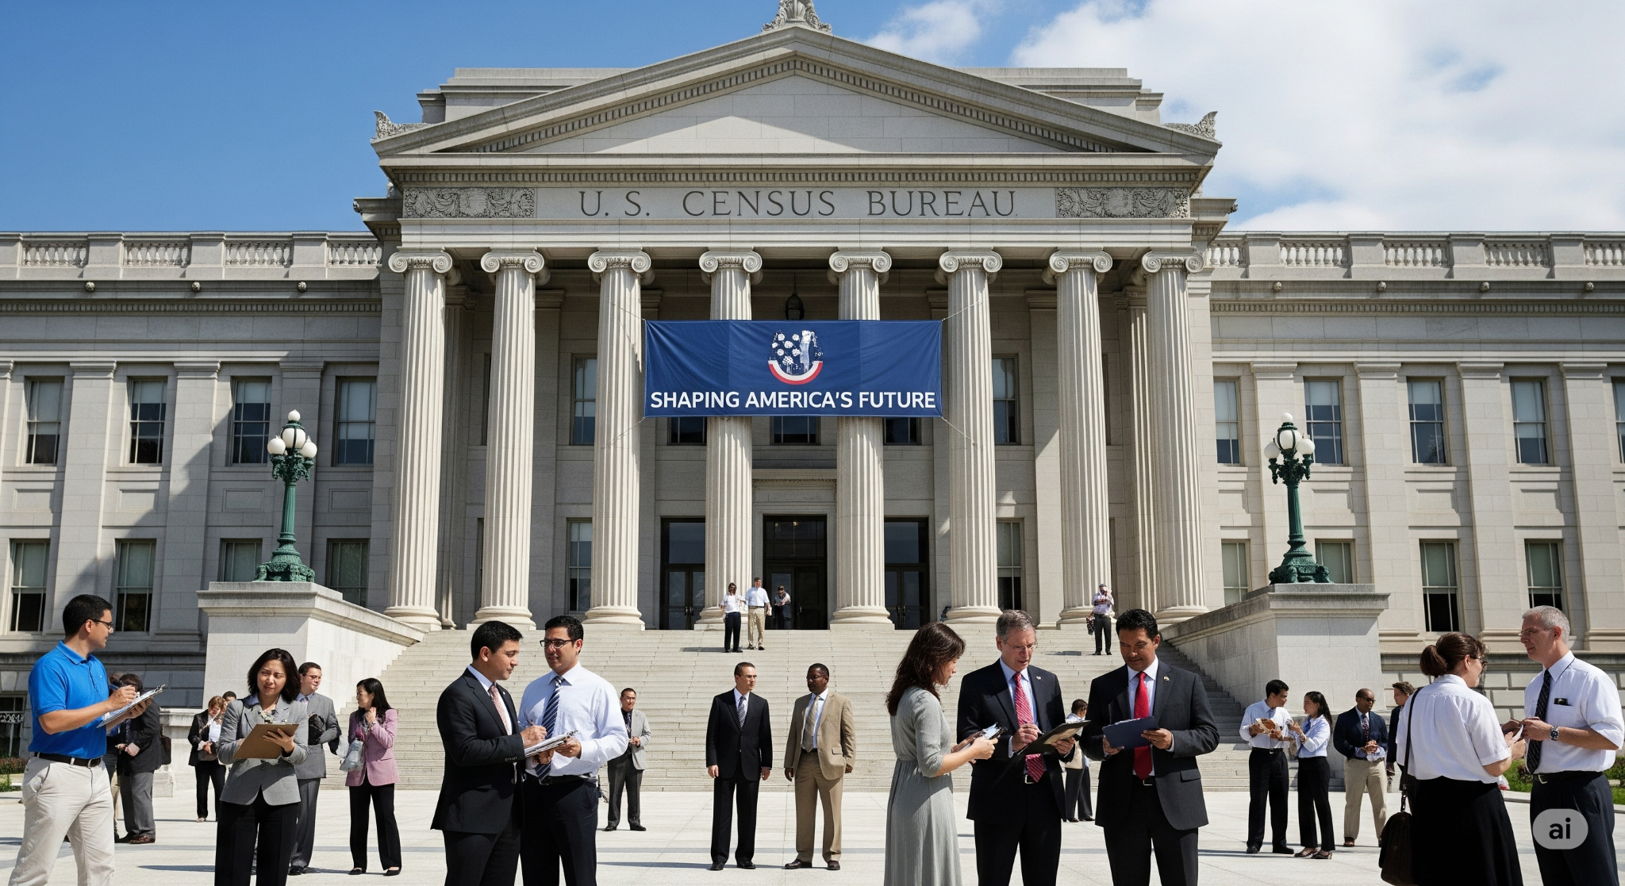
US Census Bureau - Retail Sales Estimate
MARTS is a monthly report that gives an estimate of U.S. retail and restaurant sales.
Sourced monthly sales data from about 4800 businesses.
Monthly report is released between the 14th and 17th.
MARTS(Advanced Monthly Retail Trade Survey)

Slide 3
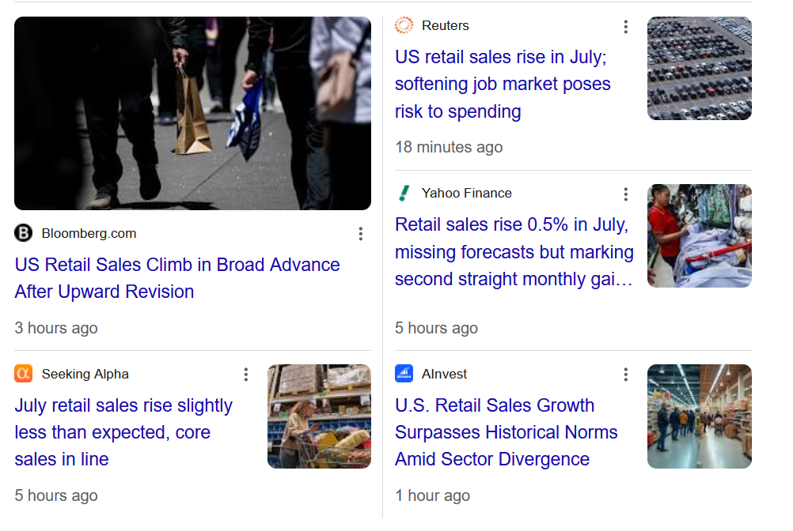
Markets Reaction to July’s Report Released this Morning

Slide 4

Challenges with US Census Bureau Report
Despite its importance, the MARTS report presents several key challenges for timely and precise decision-making:
Sampling error: Often Revised Surveying only part of businesses means results may differ from a full count, creating a margin of error.
Delayed Response: Bureau has to make estimates for businesses which do not respond to the surveys on time.

Slide 5
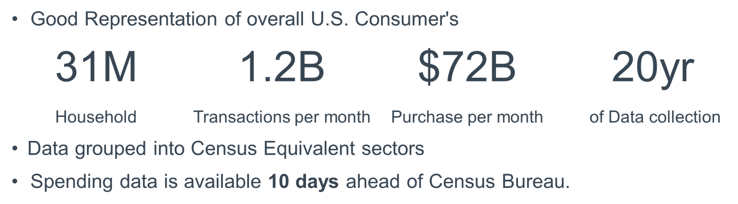
Alternative Approach-Leveraging Bank’s Real Consumer Spending Data

Slide 6
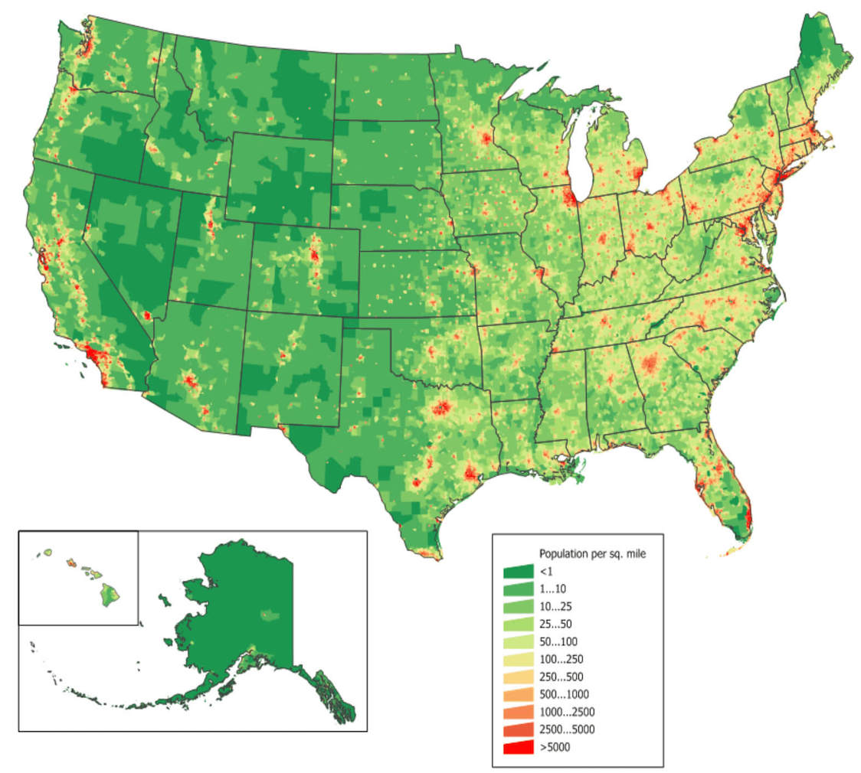
USA Population Density per Sq. Mile

Slide 7

Banks Branch Location Density

Slide 8
Methodology
Objective: Predict the month‑on‑month (MoM%) change for U.S. Census Bureau sales data using linear regression.
Independent variable: MoM% of bank's sales amounts (per sector).
Dependent variable: MoM% of Census Bureau sales (per sector).
Data period: 60‑month rolling window spanning back from the current month.
Modeling steps:
• Compute MoM% for both bank and Census data for each sector.
• Fit a linear regression model on the 60‑month X (bank) and Y (Census) series.
• Input the current-previous month’s (July) bank MoM% into the model to predict the Census MoM%.
• Transform the predicted MoM% back to a dollar sales figure.
Key result: The overall MoM% change is obtained by comparing the aggregated predicted Census sales with the actual total bank transaction sales for the current month.

Slide 9
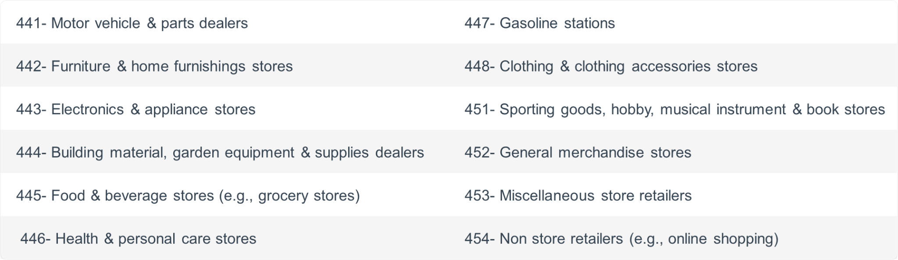
Retail Sectors

Slide 10
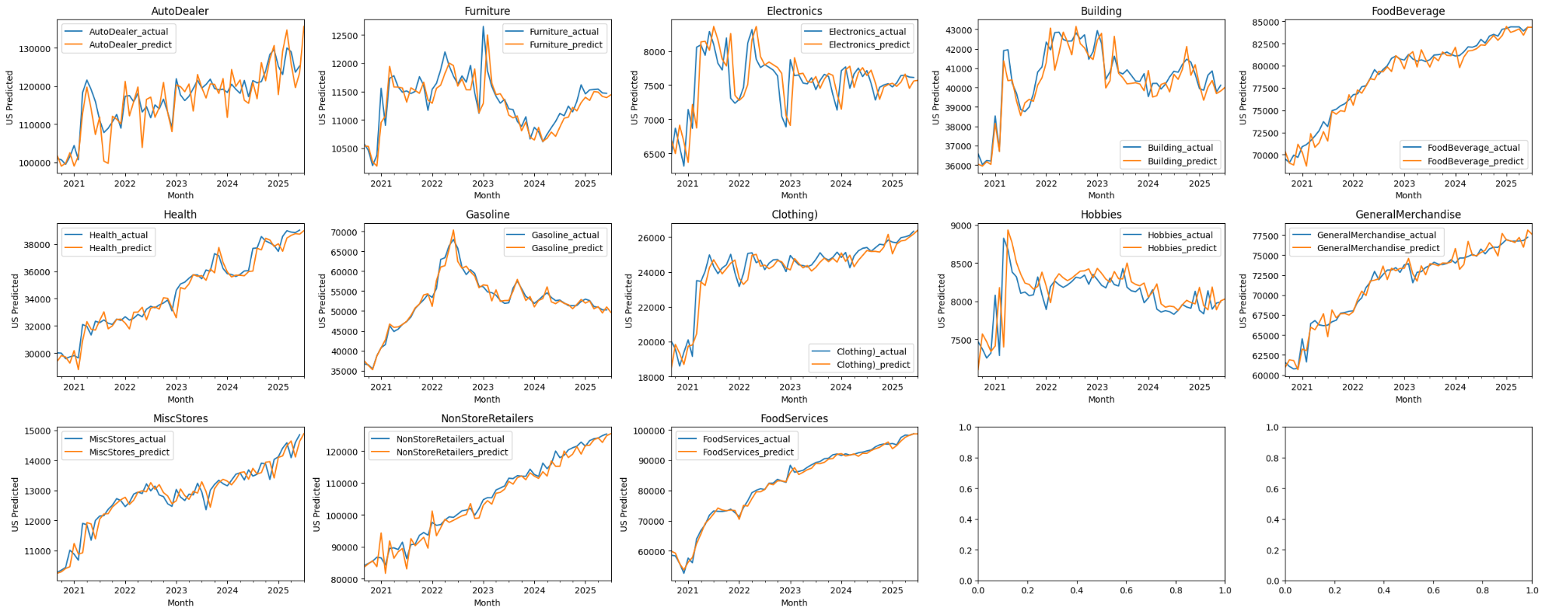
Results by Sector

Slide 11
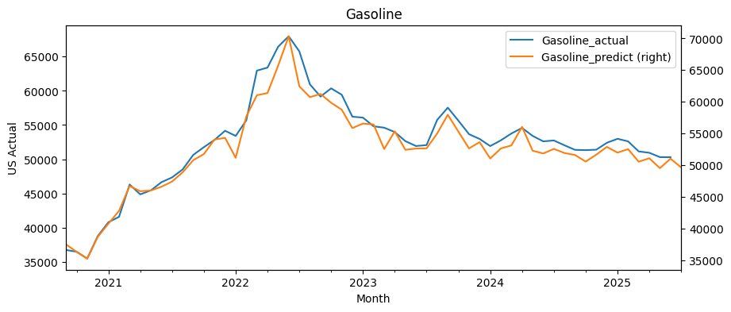
Insights

Slide 12
Insights

Slide 13
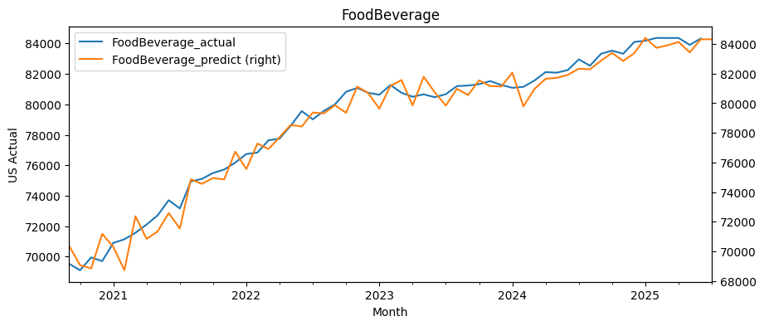
Insights

Slide 14
Insights

Slide 15
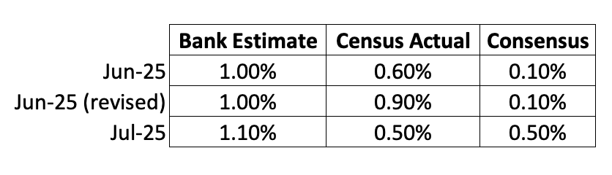
Final Result

Slide 16
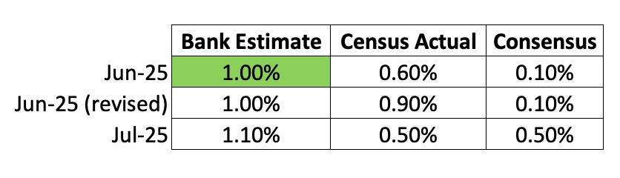
Final Result

Slide 17
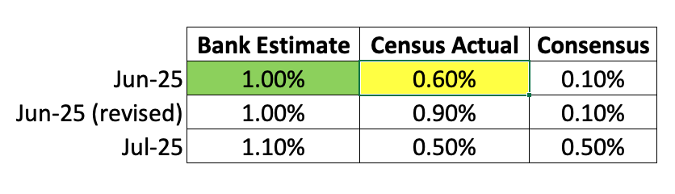
Final Result

Slide 18
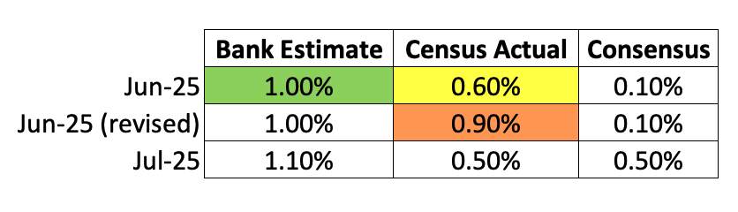
Final Result

Slide 19
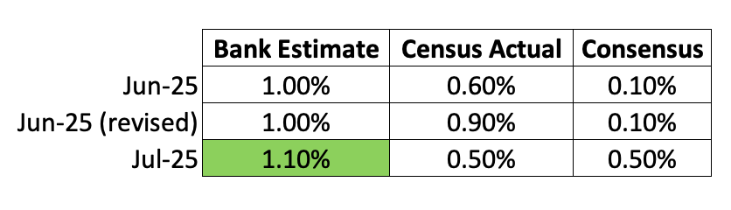
Final Result

Slide 20
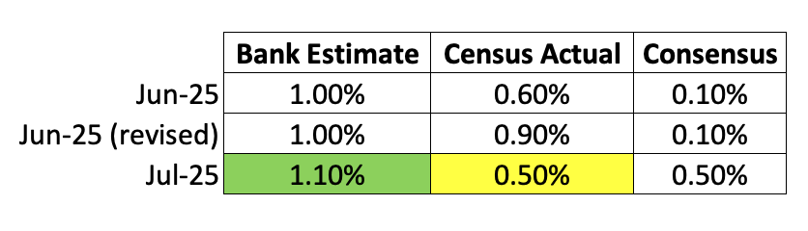
Final Result

Slide 21
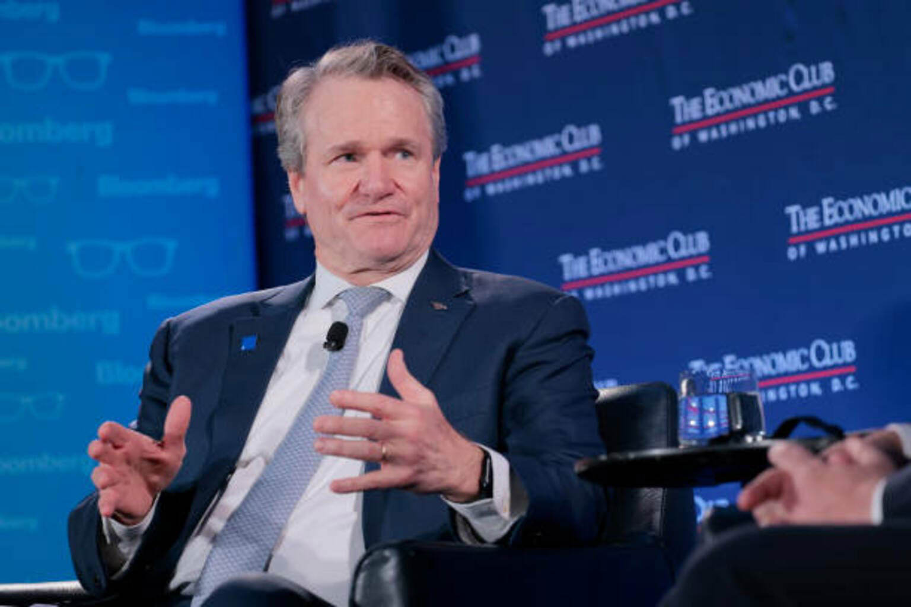
"Our economists believe there will be no recession"
"For the month of July 2025 vs. the month of July 2024, our consumers pushed 5% more-plus in the economy from their accounts"

